Slide 1



E7 PROJECT
Leveraging Machine Learning
for Architectural Design Optimization
Prepared By:
Dixit Nisarg Avinashkumar (22B2515)
Rajit Khandelwal (22B2522)
Ajinkya Pawar (22B2514)
Nihir Shah (22B0350)
DS 203

Slide 2
INTRODUCTION
We are given here a data of 1183 building layout images, each in the form of a 640 x 480 pixel bitmap. The goal is to utilize data science and machine learning methods to analyze these images and extract valuable insights.
We have to group the designs into shape-based families to standardize and gain insights.
Secondly, we have to classify layout complexity into low, medium, and high categories to establish criteria for assessment.
Further, We have to develop a system to regain relevant layouts based on specified parameters like dimensions and complexity.

Slide 3

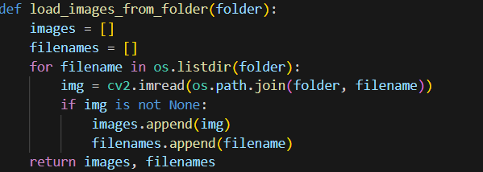
Executive Overview (Approach 1) - Part 1
In our code then we utilized the load_images_from_folder function to load images from the specified directory (E7-images).
Code daal dena idhar
IMAGE LOADING AND PREPROCESSING:

Slide 4
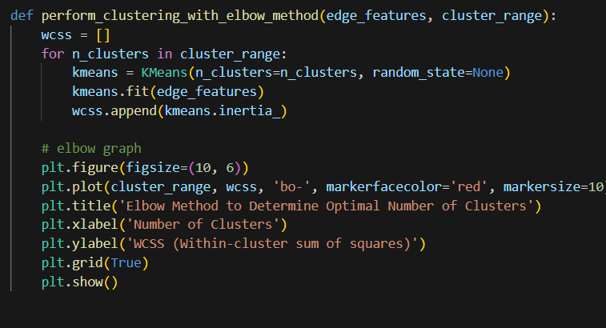
Executive Overview (Approach 1) - Part 1
We use the elbow method to find the optimal number of initial clusters required for clustering the images
Code daal dena idhar
ELBOW METHOD

Slide 5
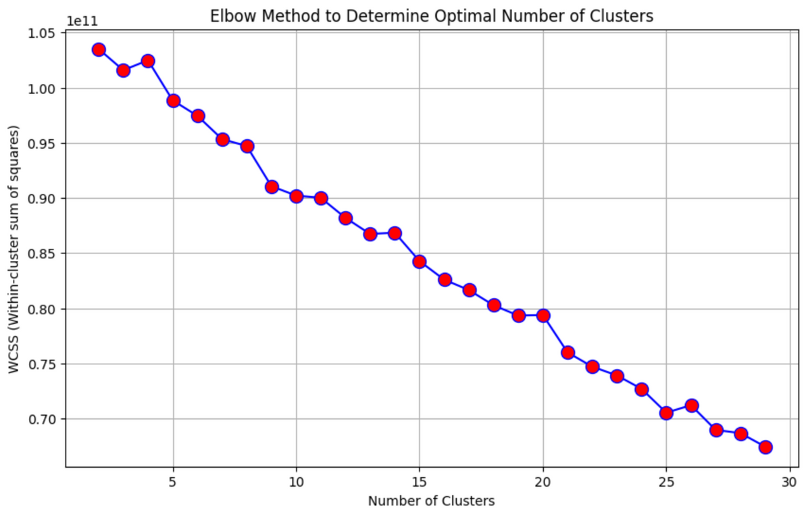
Executive Overview (Approach 1) - Part 1
Here n=20, as graph becomes linear from here
RESULTS AND ANALYSIS:

Slide 6
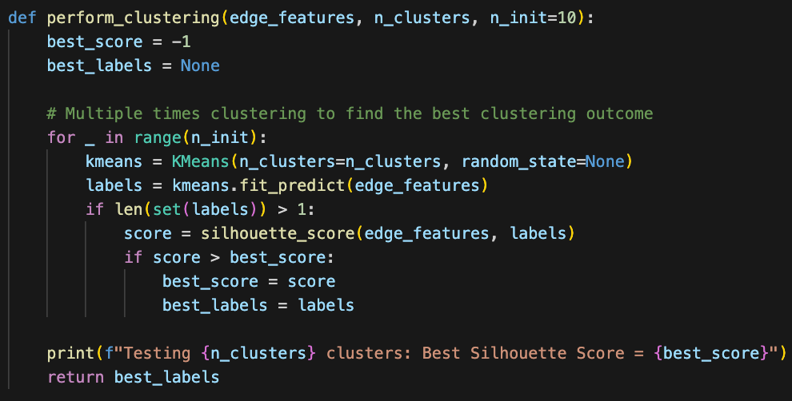
Executive Overview (Approach 1) - Part 1
We divide the images into 20 clusters with the help of K-Means clustering
We perform Clustering for total of 10 times to increase the accuracy
CLUSTERING OF IMAGES:

Slide 7
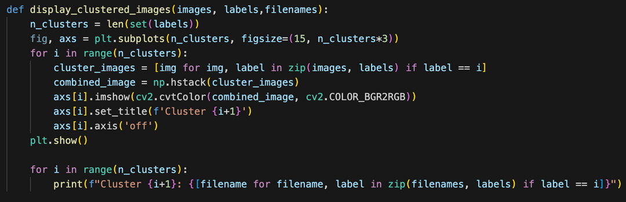
Executive Overview (Approach 1) - Part 1
In this segment of the code we will visualize the clustered images using the display_clustered_images function.
After this for each cluster, segregate the images belonging to that cluster horizontally and display them and assign titles to the subplots indicating the cluster number.
DISPLAYING CLUSTERED IMAGES:

Slide 8
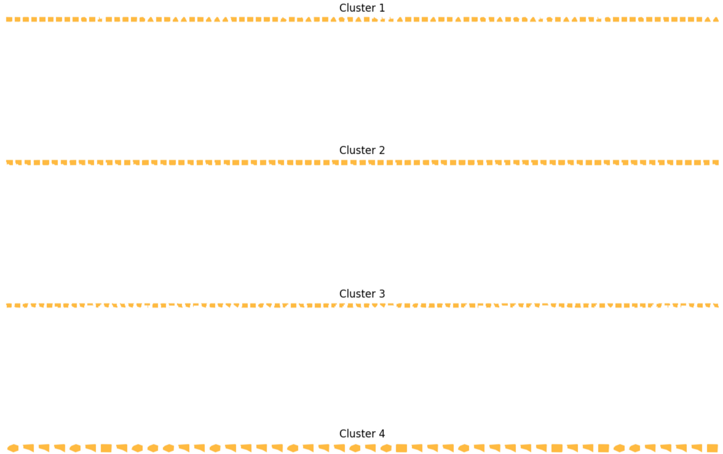
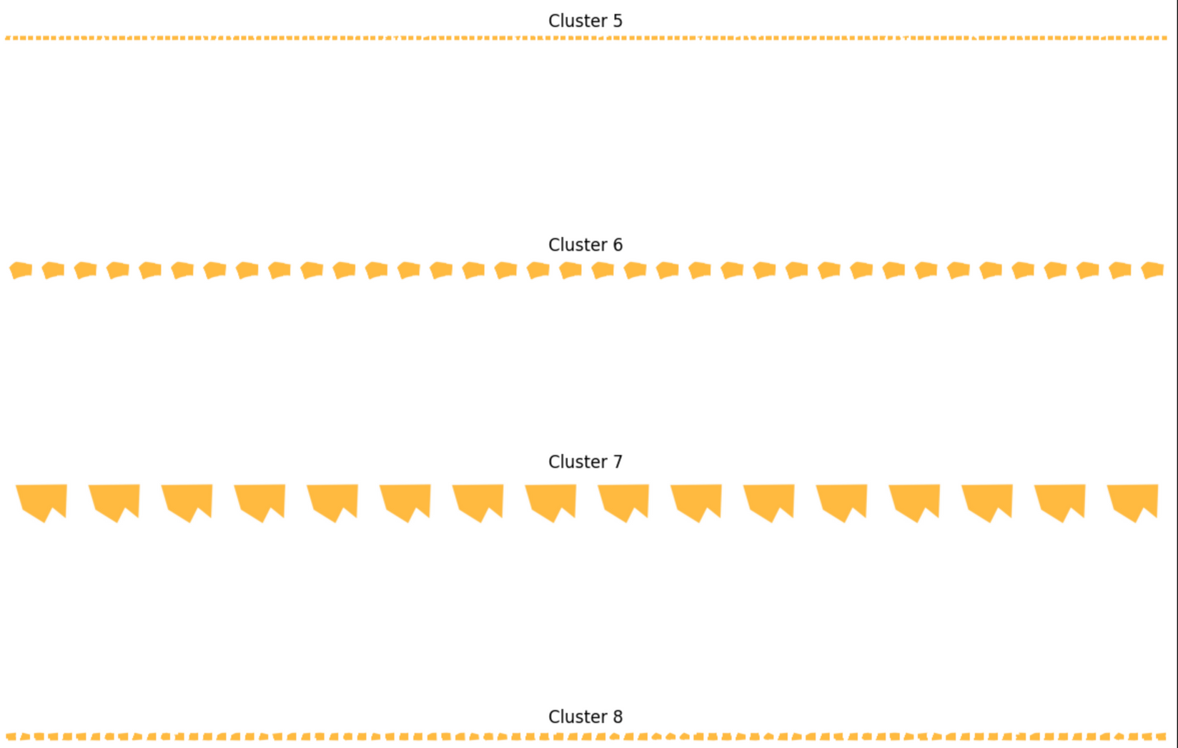
Output of Part 1 (Approach 1)
Thus, we can see that the images are getting clustered into 20 different clusters

Slide 9
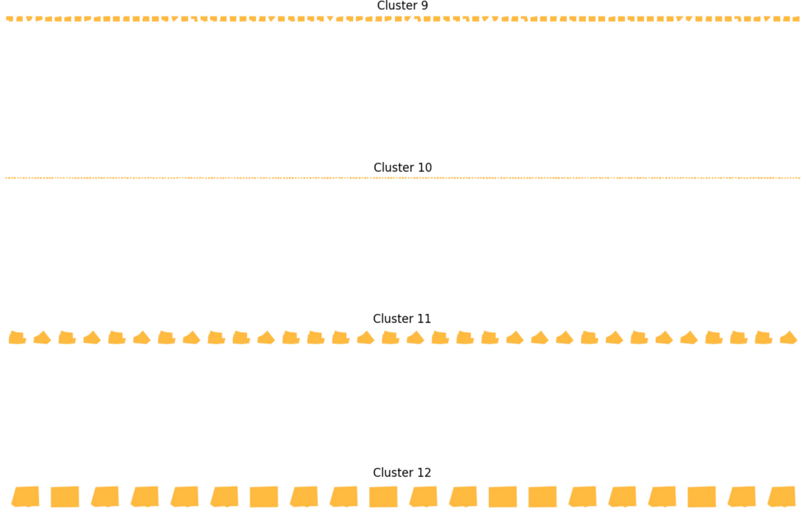
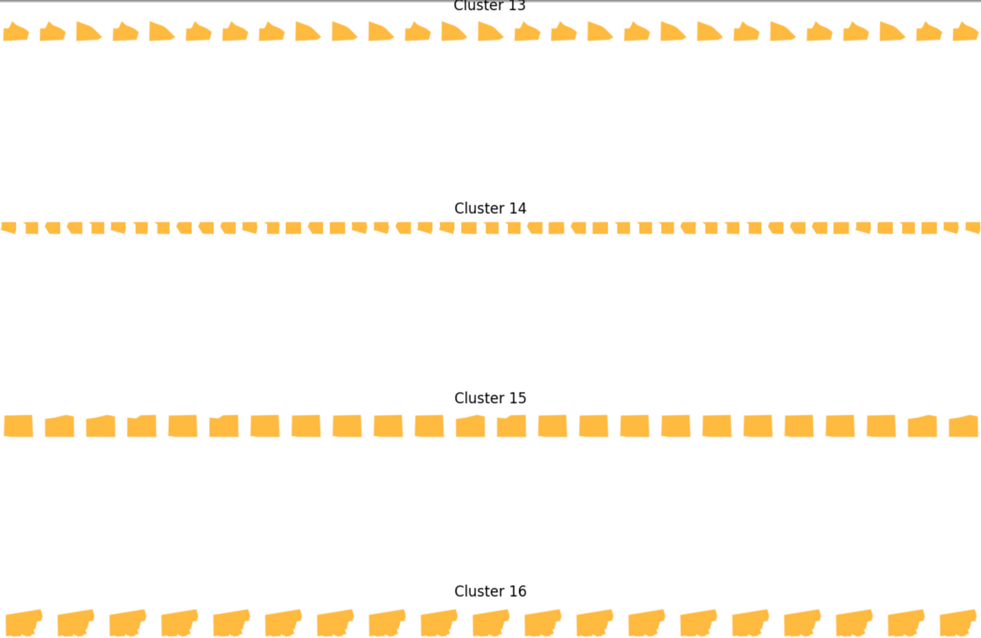
Output of Part 1 (Approach 1)

Slide 10
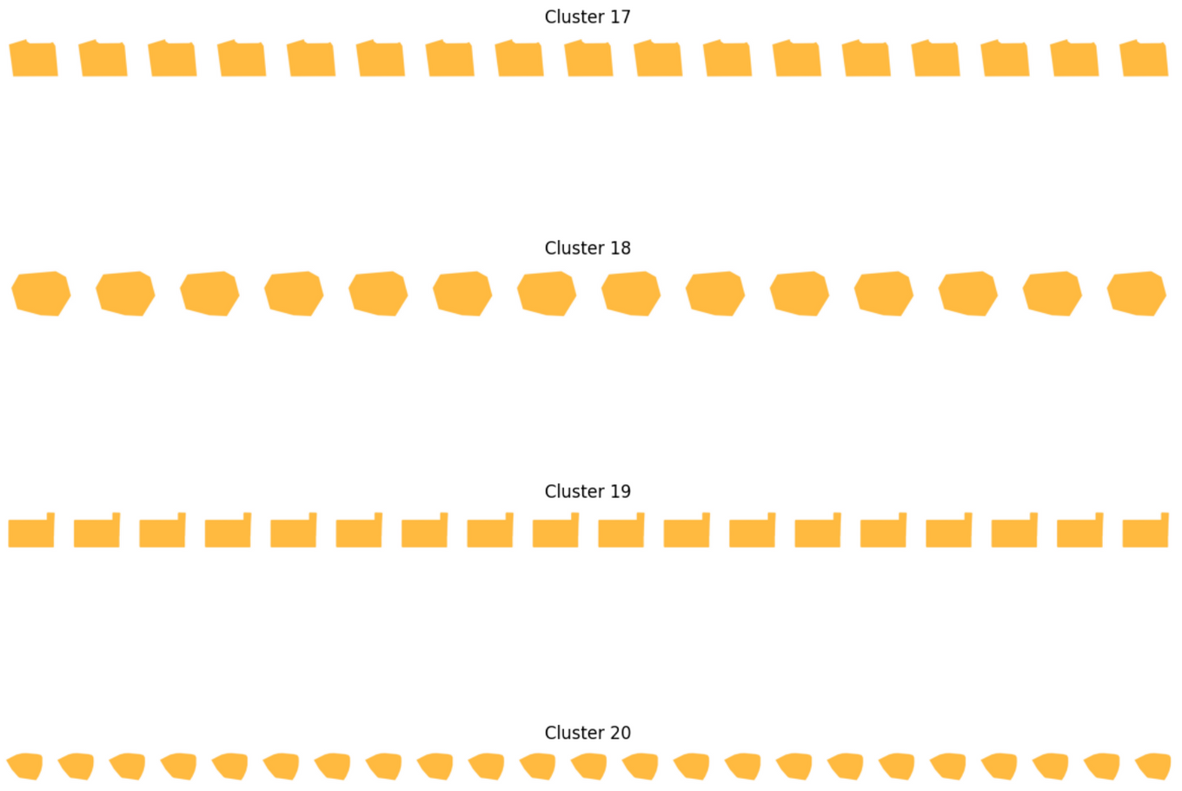
Output of Part 1 (Approach 1)

Slide 11
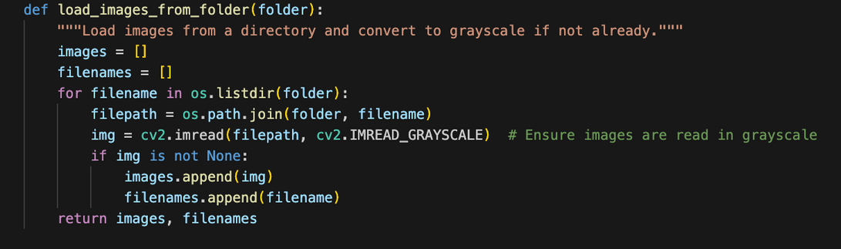
Executive Overview (Approach 2) - Part 1
This segment of the code will load images from the specified directory.
Ensuring uniform representation by preprocessing.
IMAGE LOADING AND PREPROCESSING:

Slide 12
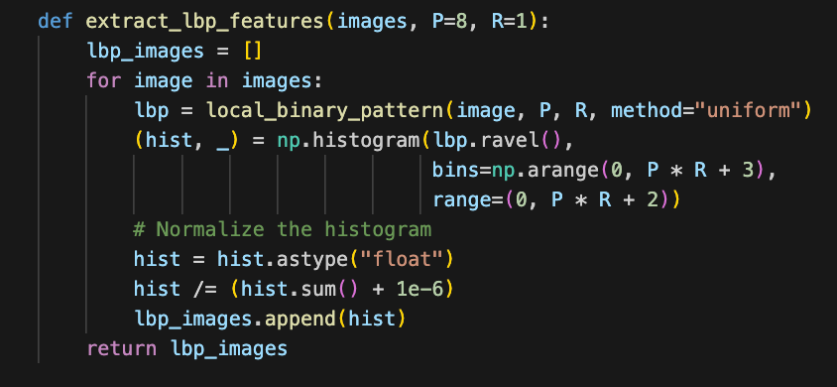
Executive Overview (Approach 2) - Part 1
Utilizing Local Binary Pattern (LBP) technique to extract texture features from the grayscale images.
Computing local texture descriptors for each pixel by comparing intensities with neighbors.
LBP is invariant to monotonic grayscale transformations, making it robust against variations in illumination
FEATURE EXTRACTION USING LOCAL BINARY PATTERN (LBP):

Slide 13
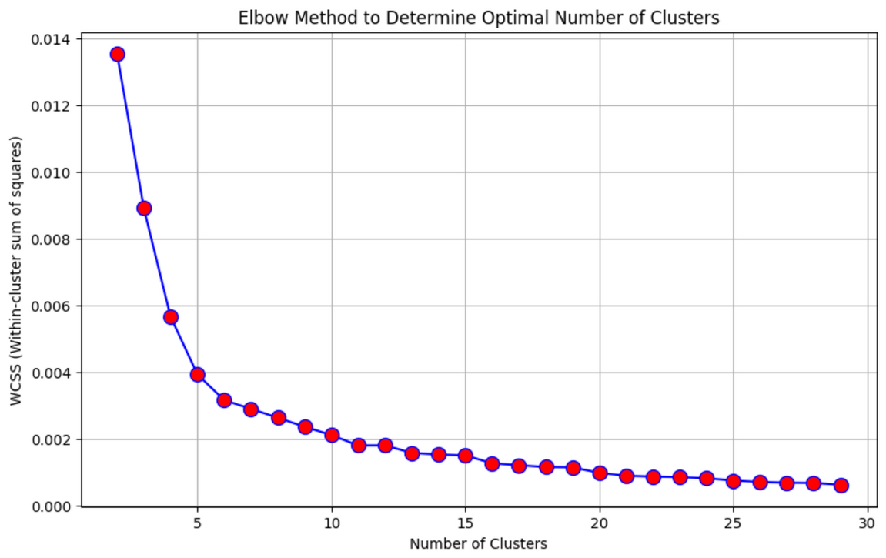
Executive Overview (Approach 2) - Part 1
Now, again we use the elbow method to find the optimal number of initial clusters required for clustering the images
Here, n=22, as the graph becomes linear from here
ELBOW METHOD:

Slide 14
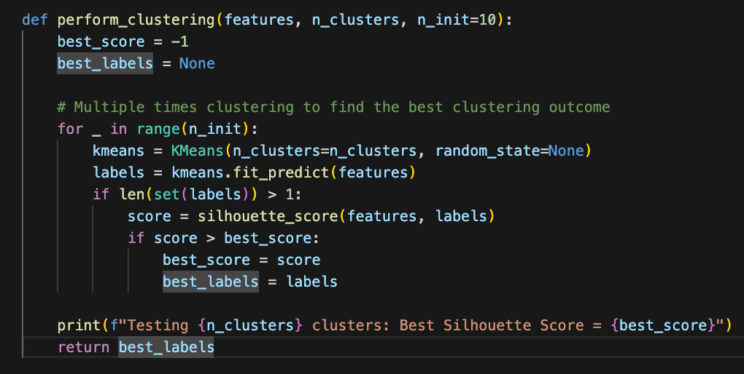
Executive Overview (Approach 2) - Part 1
We divide the images into 22 clusters with the help of K-Means clustering
We perform Clustering for total of 10 times to increase the accuracy
K-MEANS CLUSTERING:

Slide 15
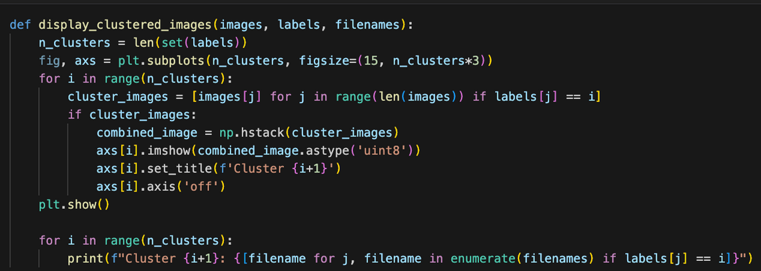
Executive Overview (Approach 2) - Part 1
Here, we have displayed clustered images for inspection of grouping based on texture patterns.
Each cluster here represents group of images with similar texture characteristics.
VISUALIZATION OF CLUSTERING RESULTS:

Slide 16
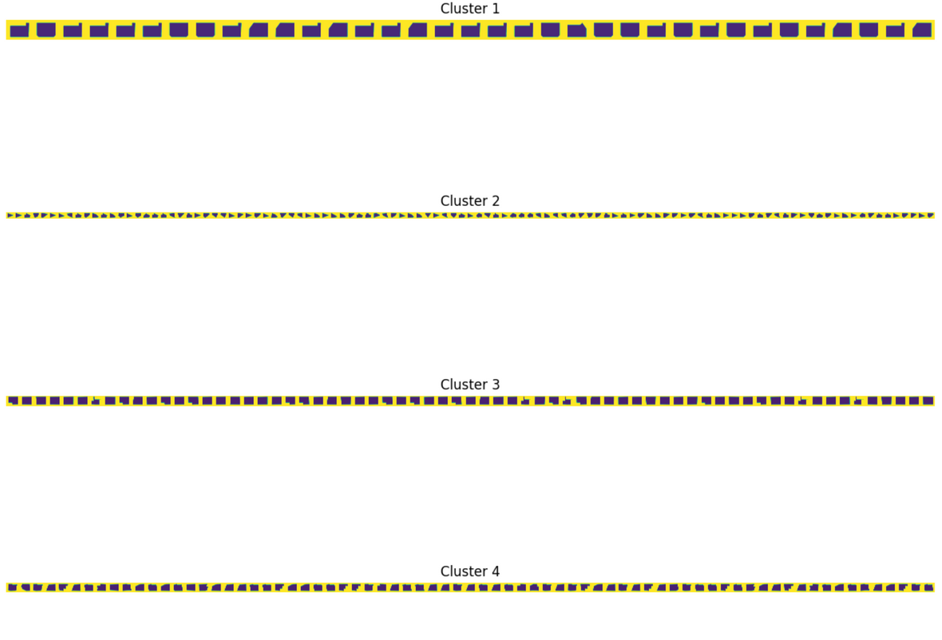
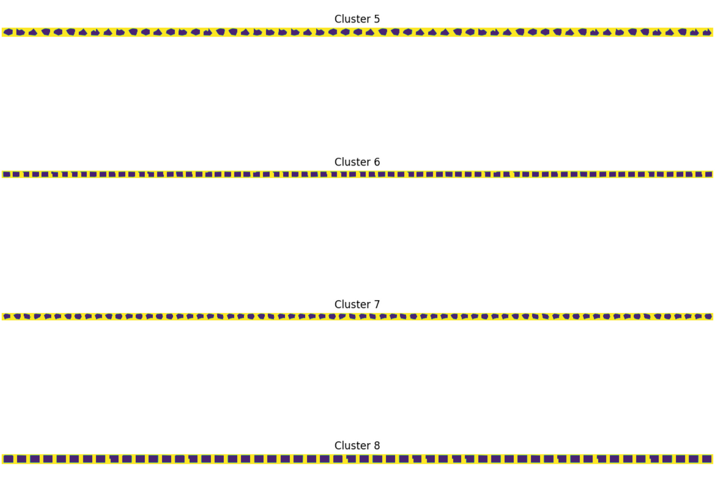
Output of Part 1 (Approach 2)
Thus, we can see that the images are getting clustered into 22 different clusters

Slide 17
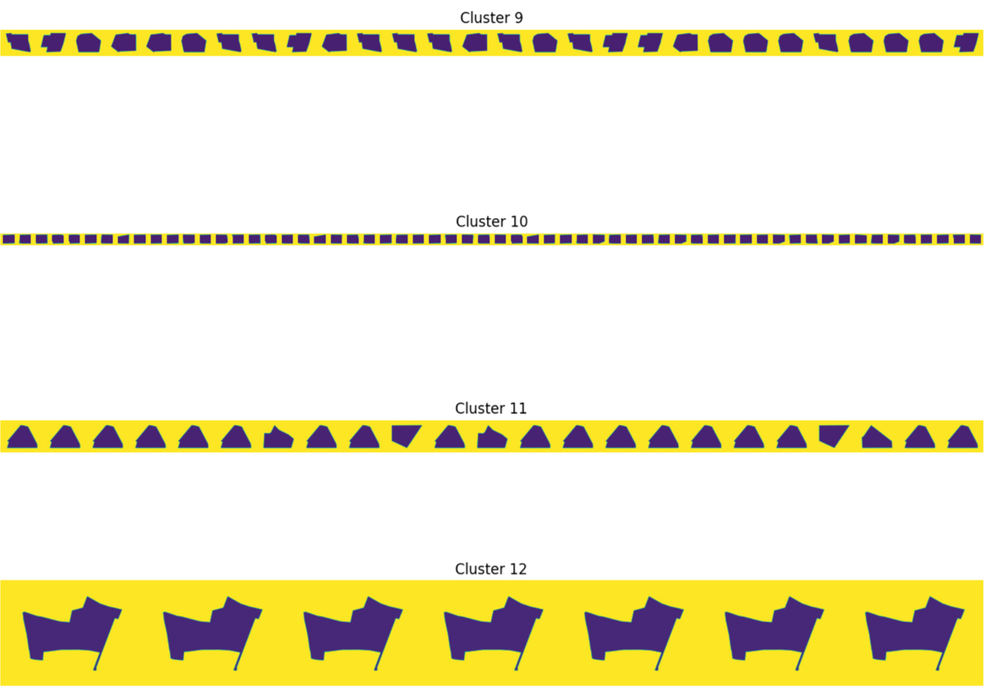
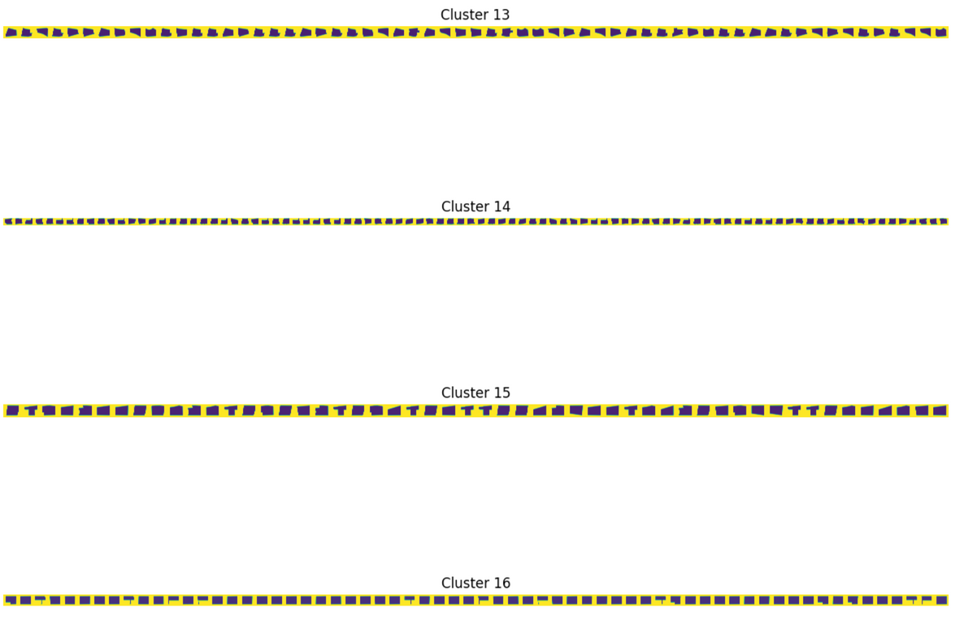
Output of Part 1 (Approach 2)

Slide 18
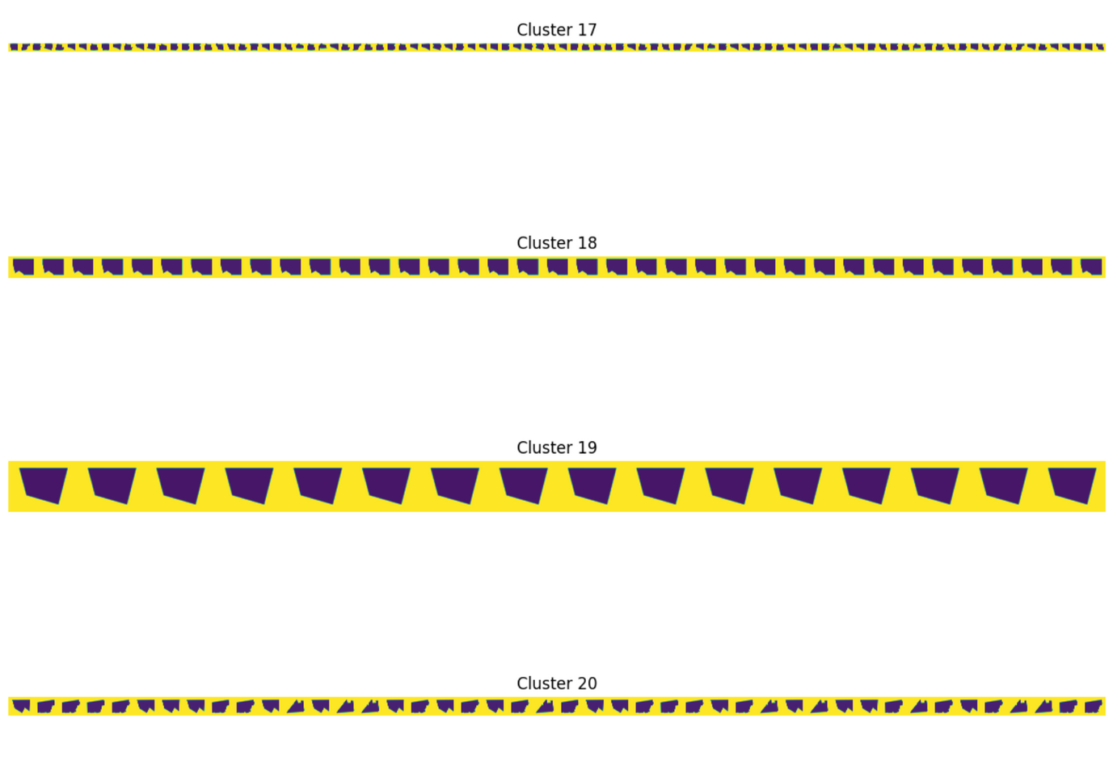
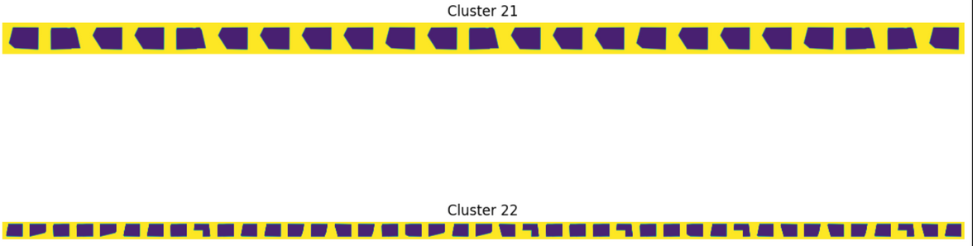
Output of Part 1 (Approach 2)

Slide 19
Conclusion to Clustering of Images
On observing both the approaches, LBP gives better output as compared to Canny Edge Detection which can be easily seen in the output graphs of the elbow method and the final output as well

Slide 20
APPLICATION & RELEVANCE
Beneficial for architectural layout analysis in identifying similar design patterns based on texture features.
Assists architects in categorizing designs and identifying common themes within projects.

Slide 21
ADVANTAGES & LIMITATIONS:
Advantages: Simple yet effective method for texture-based clustering, suitable for basic pattern analysis.
Limitations: It may not capture all architectural diversity patterns, as it relies whole on texture patterns for clustering.

Slide 22
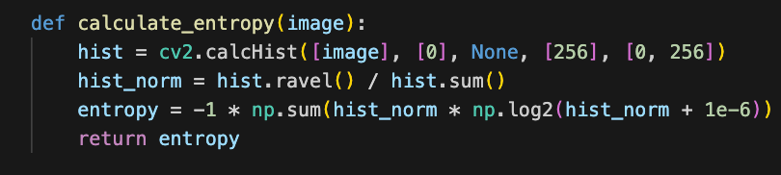
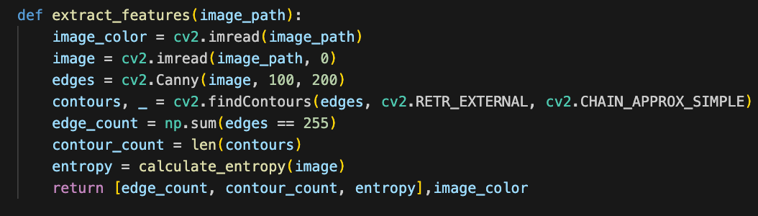
Executive Overview - Part 2
Extracted features: Edge count, contour count, and entropy.
Edge count: Measure the number of edges detected in the layout.
Contour count: Number of distinct contours detected in the layout.
Entropy: Quantitative measure of image complexity based on pixel intensity distribution.
FEATURE EXTRACTION AND ANALYSIS:

Slide 23
Executive Overview - Part 2
Utilize KMeans clustering algorithm to classify layouts into three complexity categories: Low, Medium, and High.
Further Classification based on the combination of extracted features and their normalized values.
Criteria for classification:
Low Complexity: Layouts with fewer edges and contours, and lower entropy values.
Medium Complexity: Moderate number of edges and contours, and moderate entropy values.
High Complexity: Layouts with numerous edges and contours, and higher entropy values.
COMPLEXITY CLASSIFICATION CRITERIA:

Slide 24
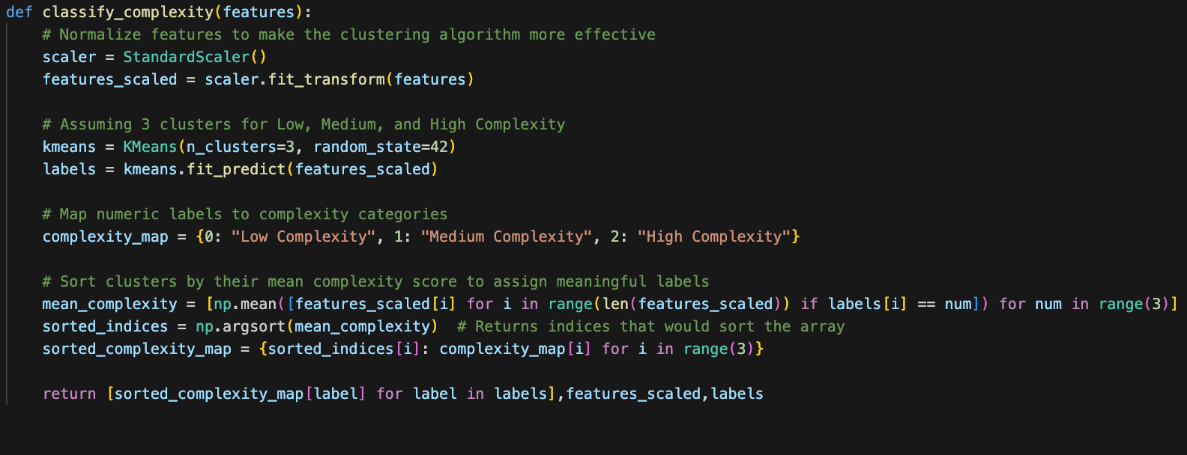
Executive Overview - Part 3

Slide 25
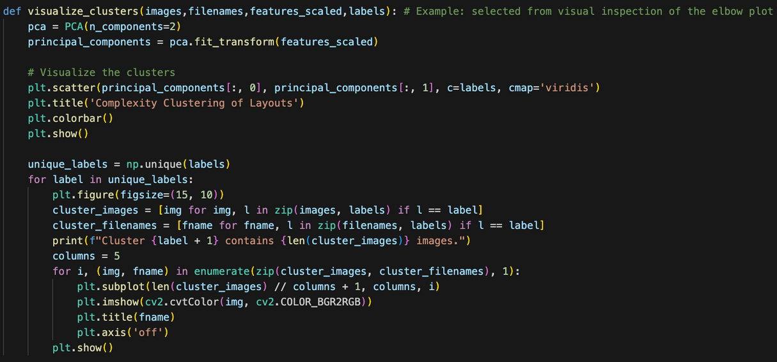
Executive Overview - Part 2
Visualizing clustered layouts based on their complexity using PCA for dimensionality reduction.
Scatter plot representation enables easy interpretation of complexity clusters.
VISUALIZATION OF CLUSTERING RESULTS:

Slide 26
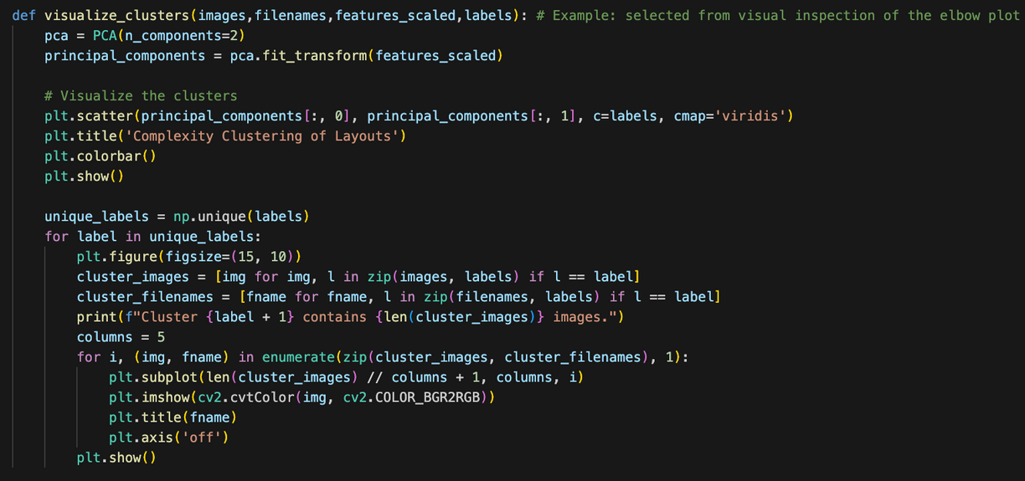
Executive Overview - Part 2
Classify the sample layouts into complexity categories based on the established criteria.
Sample layouts categorized into Low, Medium, and High Complexity classes.
SAMPLE LAYOUTS CLASSIFICATION:

Slide 27
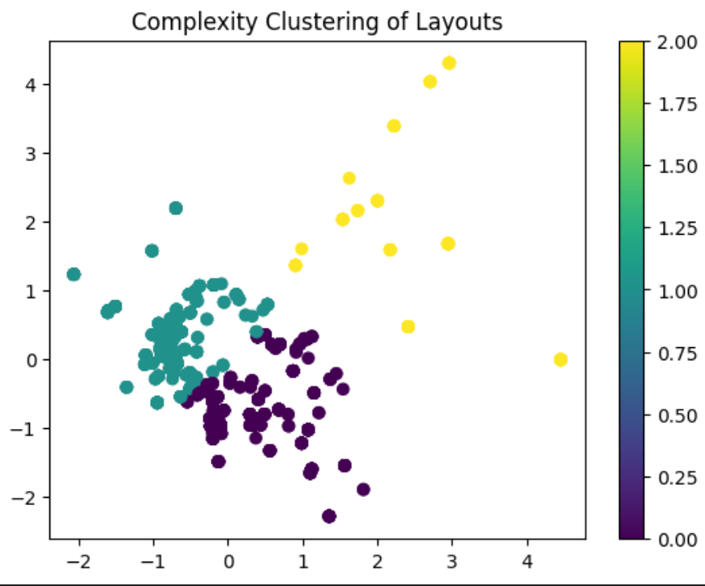
Executive Overview - Part 2
Here, we can see that the images are divided into 3 clusters with labels 0,1 and 2. As we go from 0 to 2, the complexity of the image increases.
Yellow - High Complexity
Aqua - Medium Complexity
Purple - Low Complexity

Slide 28
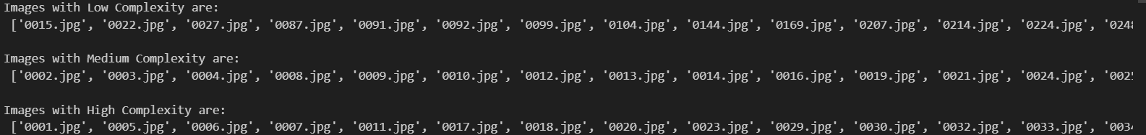
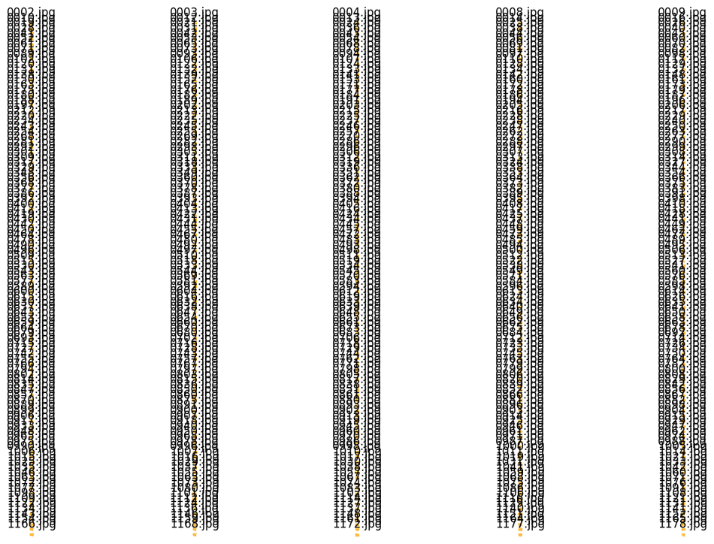
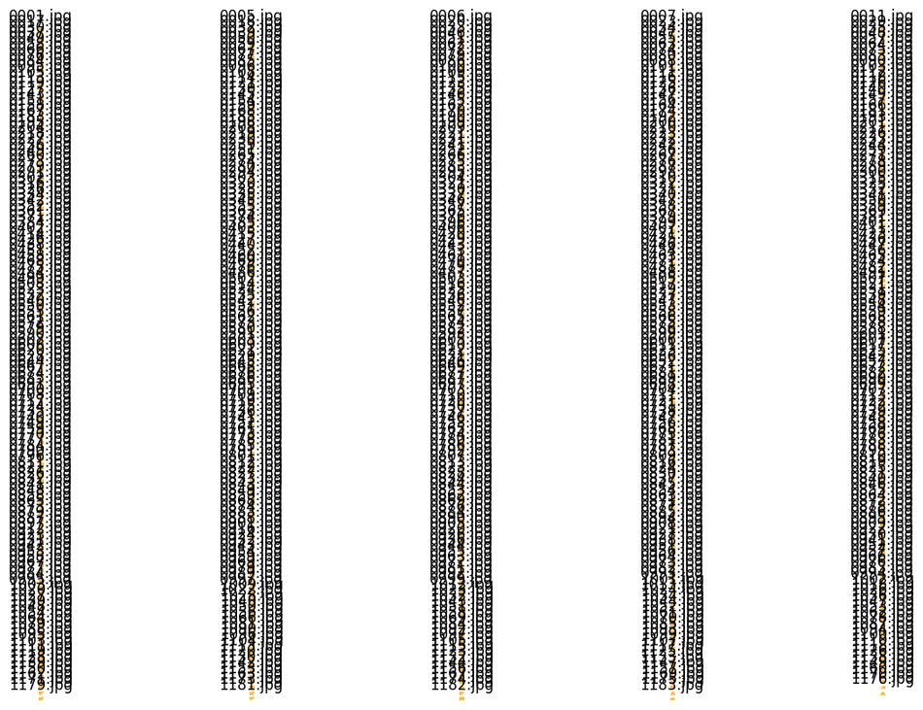
OUTPUTS:
High complexity images
Medium complexity images

Slide 29
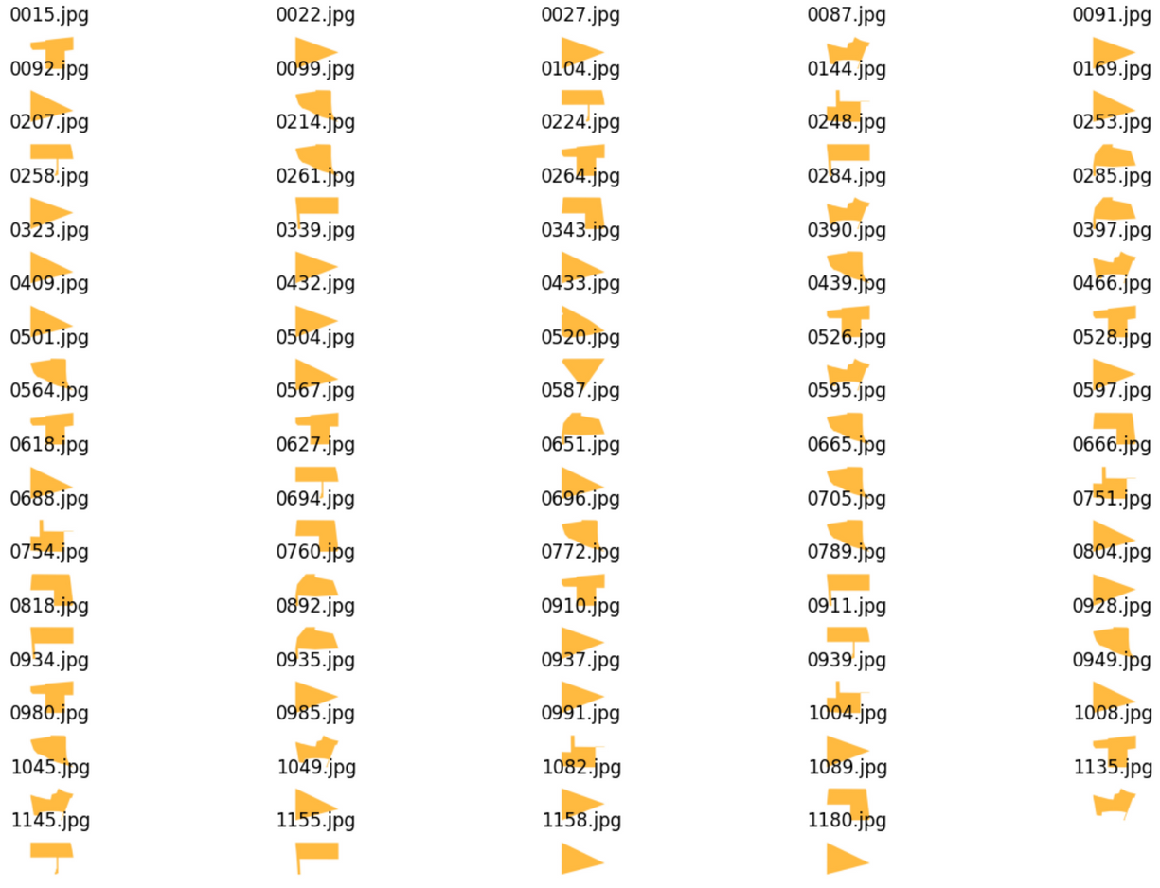
Low complexity images

Slide 30
Executive Overview - Part 3
The basic idea is that we have first created a tight bounding box around the images and then used its parameters like area, height, width, perimeter etc to train a kNN model that identifies the nearest images when we input the required variables. The toughest part was to create a tight bounding box and that is what we had to spend most of our time on.

Slide 31
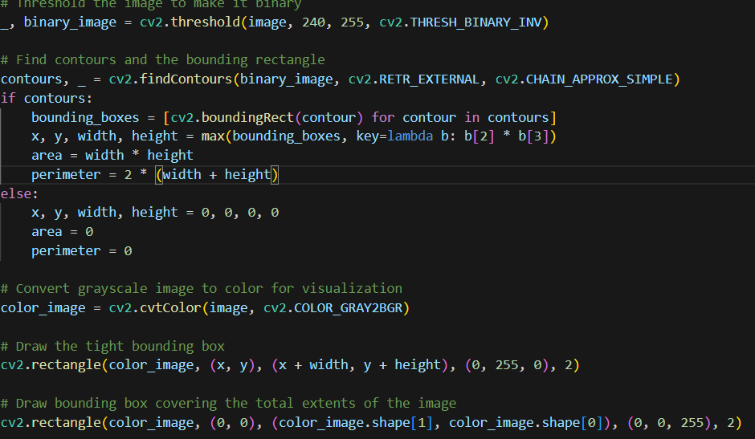
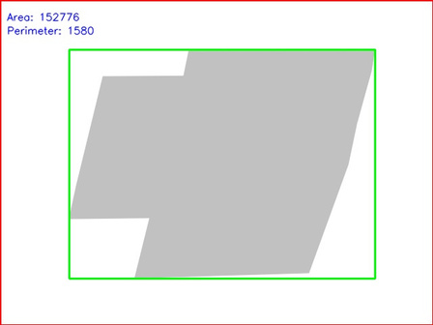
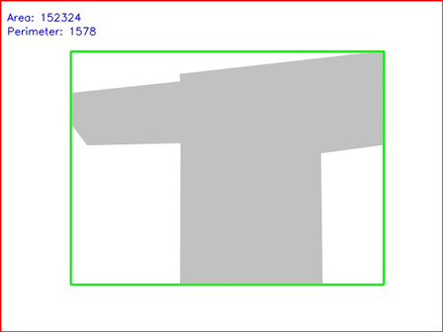
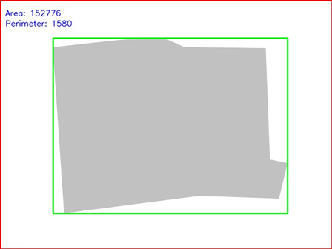
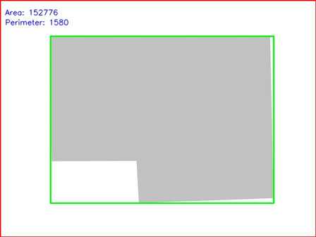
This is the code for finding the contours using cv2.findcontours and then we used the find contours to create a tight bounding box and use its perimeter, area etc to train our model
x
This is the example of what our tight bounding boxes look like

Slide 32
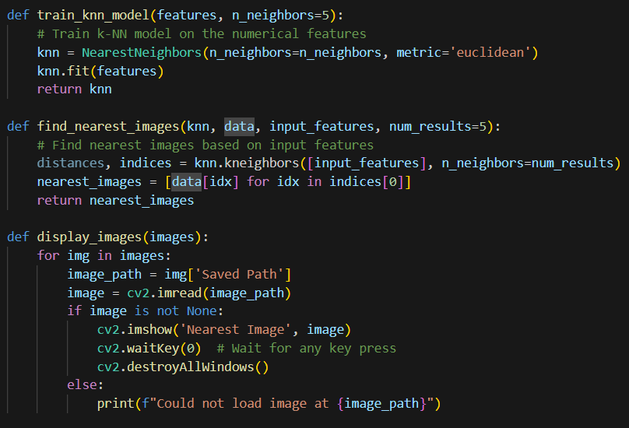
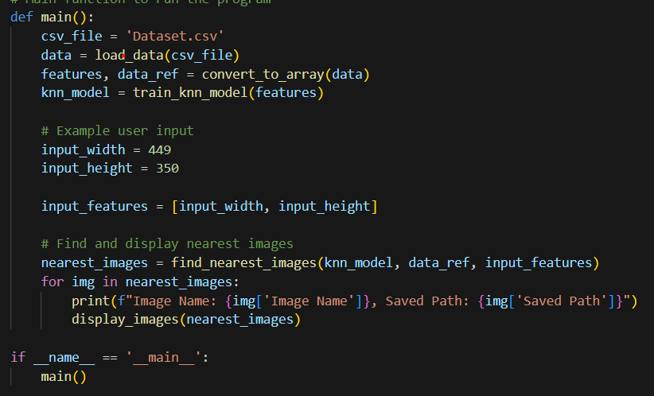
This is the code for training our model on features
which are width and height, we first
also tried using perimeter and area but they were
almost same for all bounding boxes hence we
ended up using just width and height to train our
model to makke it simpler and require less computing
power
This is the code to call nearest images based on height and width which gave us around 15 images when we put width as 449 and height as 350

Slide 33

Conclusion
We clustered images by using features as edges, contours, and LBP,etc.
We have divided images into low, medium and high complexity using parameters like contours, edges and entropy
We have also trained a model to identify nearest images on the basis of width and height thus, we can use the above two to find images as required by the architect thus solving the problem statement effectively
We have used KNN multiple times to improve the accuracy of the clustering
We have also used PCA analysis to reduce the dimensionality and visualise the clusters effectively
Thus we believe our model and output is backed by appropriate metrics including all possible aspects of the given images with analysis and justifications based on the tight bounding box we have created

Slide 34

Learnings
We learnt mainly about Image Processing like different features which can be extracted from a image such as edges, contours, etc. and the different methods for that.
We also learnt a bit about feature engineering, output analysis and also about elbow method which is used to find the optimal number of initial clusters required for clustering
There were some hurdles while completing the project such as few errors in using different functions of various python libraries, data processing an feature extraction, etc.
It was an amazing and all-new experience working on image processing. We enjoyed a lot

Slide 35
THANK YOU
DS203
IIT Bombay

